Slide 1

Red House Farm Allotment Society
89th Annual General Meeting
Notes:
Welcome all to the 89th AGM for Red House Farm Allotment Society!

Slide 2
Agenda
Housekeeping and Introduction
Previous Minutes and Matters Arising from the July 2025 AGM
Chair’s Report
Financial Report
Shop Report
Elections
Any other business
Notes:
Here is our agenda. Housekeeping. Fire exits are located…and we are not anticipating a fire sounder test. Muster point is … The toilets are... Written copies of the presentation as well as other documents available at the side of the room here. Please help yourself to a drink at any time. I don’t mind people wandering about.

Slide 3

Introduction
Last AGM held July 2025
Crisis meeting 2025
Notes:
The last AGM was held in July 2025. We have not had a full year since then. The reason it was to July was because of lack of interest and attendance- an AGM can’t go ahead unless a quorum is present, that is a minimum number is met. It was hoped we could attract a greater audience later in the year because the season had started and there were more people active on the sites. Engagement has been a real challenge and something I have spent my time as Chair really focussing on.
Having given it a try, we feel a Spring AGM is more appropriate, as it allows for a more timely presentation of the finances from the previous year- we run 1st of Jan to the 31st of Dec- and gives us the opportunity to lay out our plans for the coming season and recruit volunteers.
For our new folk- we were heading into a crisis early last year and a meeting was held last April. We were really struggling with too few people trying to do too much and were close to folding the society. The council could not guarantee the allotments would continue to operate if that were the case. I’m very glad to say the meeting we held to address this was well attended, allowed us to attract the skilled people we required and put us in a much stronger position moving forward, of course that doesn’t mean that will be the case forever. We are a society run entirely by volunteers. I know many of you know that, but our new folk might not have understood to what extent. Our society wouldn’t exist without people generously offering their time for every aspect of the operations. The nature of a volunteer workforce is that there is a degree of impermanence about it. We must continually replace skills and attract volunteers to remain strong. So, we need to keep communicating.
Speaking of- for those that attended the crisis meeting- I am aware we have not reached out to all of you that offered your help. This is not because we didn’t need you! We were overwhelmed- nicely overwhelmed- and realised we needed to put a structure in place to fully benefit from volunteer offers. Don’t let it put you off today if you are interested in getting involved.

Slide 4
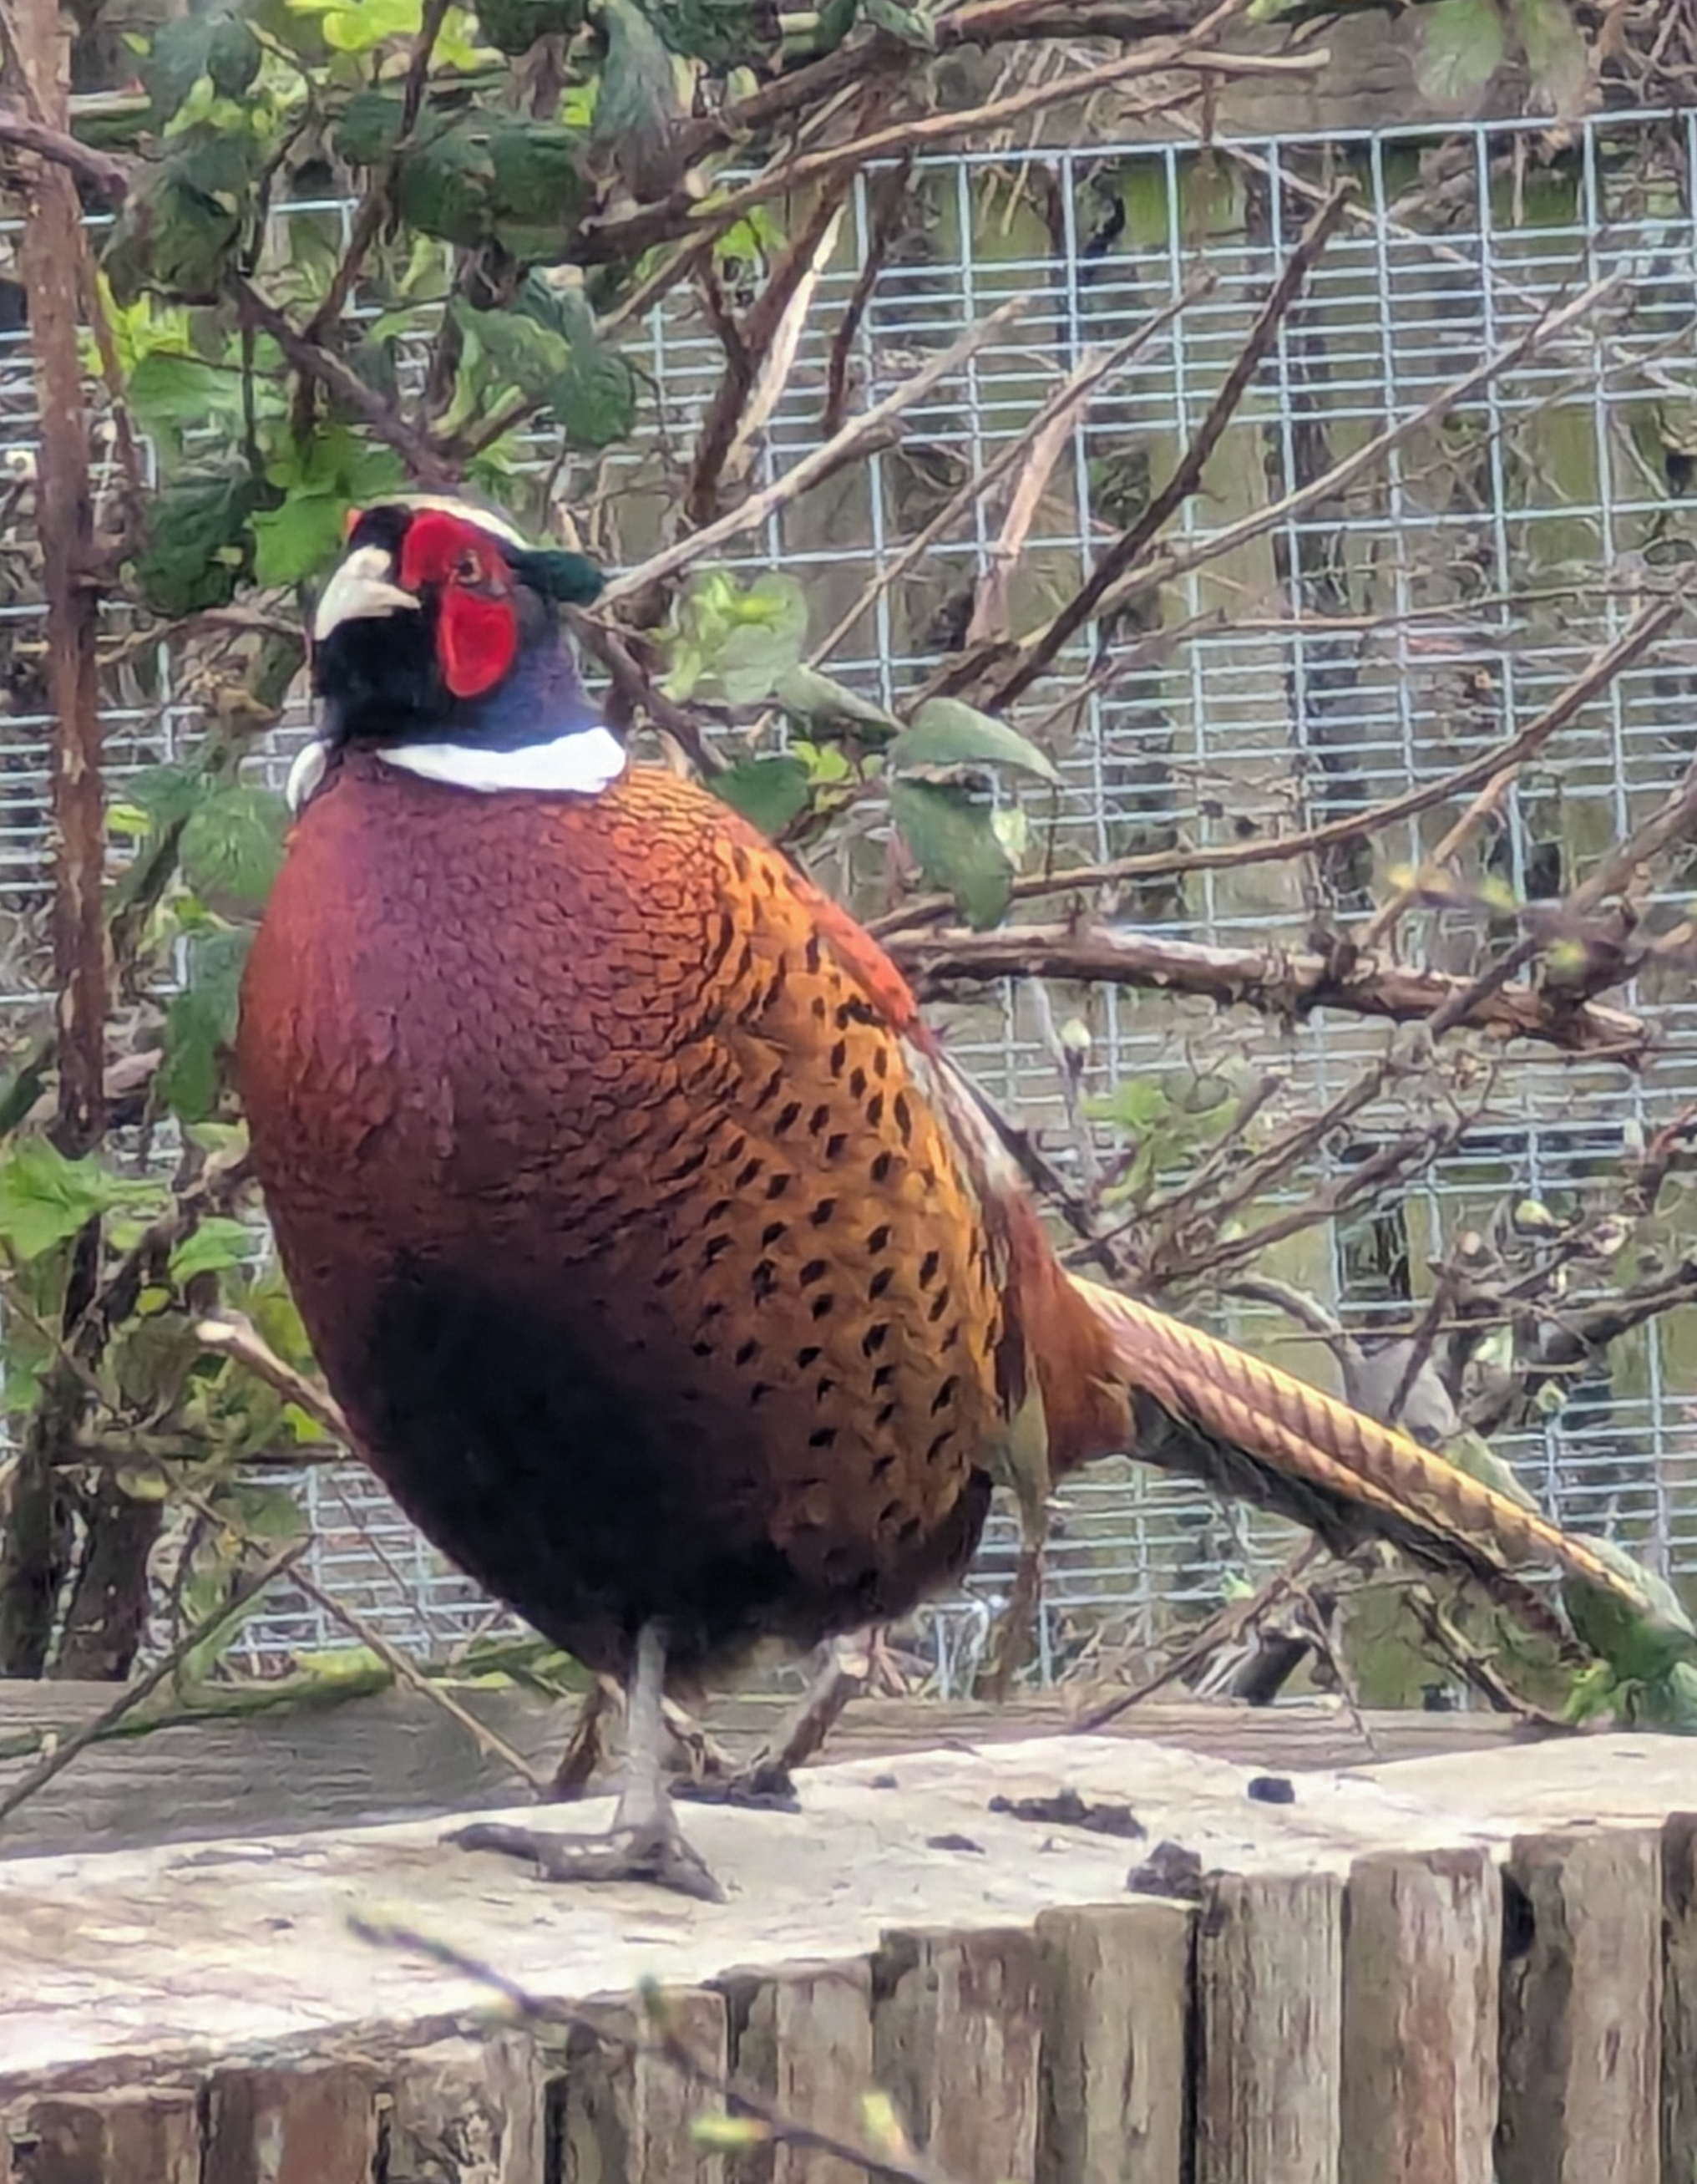
Previous Minutes and Matters Arising
Summary
Finances
National Allotment Society
Matters Arising
NAS Northern Rep
Future NAS presentation
Notes:
If you haven’t seen the minutes yet, there are copies at the side of the room. To summarise- there were two topics of discussion.
The first topic concerned the account report for 2024 - it required clarification and we will cover that in the finance report.
The second topic concerned the National Allotment Society. The National Allotment Society had requested we send all of our members contact details to them in order to continue our affiliate membership. They would not discuss any matters with us regarding our membership until we did so. To be clear, we are not concerned the about the security of your contact details with the NAS any more than we are with any other organisation. They have policies in place and need to abide by the law when holding such information, just as we do. The issue was that our committee was not comfortable being responsible for handing over your details. If you do it, that’s none of our business. This request had come about when they became digital, although it has been in their rules for ten years but not enforced, and once digital they realized what they were missing. The reason they wanted your details was in order for individuals to qualify for the free insurance. At the AGM, this was put to our members and we suggested that members become responsible for their own membership, payment and sharing contact details. Some members felt strongly that we should support the only national group concerned with allotment activities.
We will get to the matters arising from that in a moment, that was just the summary from the 2025 AGM. Before then, are the 2025 minutes agreed that they are reflective of the issues?
NAS. We took on board all feedback and decided to delve deeper with NAS. Eventually, I contacted their Northern Rep and found we were not the only society wrestling with the same circumstances. In fact, his own allotment society did not share the details of their members and assured me we would still be able to continue our membership. With this contradictory information, we persevered and have, in fact, become affiliate members renewing our society membership. We had to let it lapse so I could set up the account, which made me their point of contact. The intension is for those who are interested- me in particular- to use this year to get to know the society better. We are also going to invite the Northern Rep to present his case to enable us to understand their perspective more clearly so make better informed decisions over our personal information. We are finding a suitable date and I will let you know when that is planned.

Slide 5
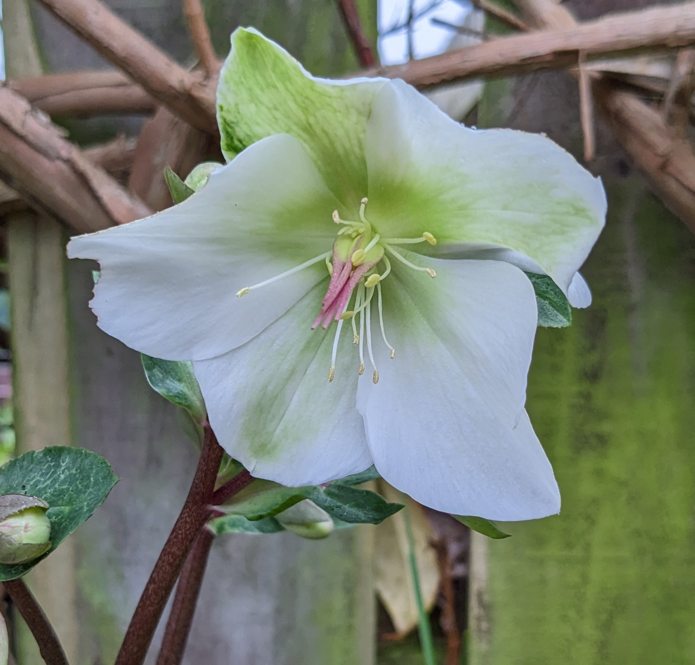
Chair’s Report
Update since last AGM
Committee activities
Volunteer roles available
Volunteer coordinator
Site/ Aisle Guardians
Stand alone tasks
Notes:
Having held our last AGM less than a year ago, you would be forgiven for thinking that not much has progressed, but behind the scenes, our committee continued to beaver away through the Winter. There is still some way to go shaping the running of the society. I acknowledge this. We are learning by trial and error throughout the year. You would also be forgiven for thinking we are slow to respond in some matters. We are. We all have jobs and other commitments, and the pace of voluntary work is a great deal slower. That is something I have had to get used to, too. We will never be able to operate at the same pace as a business. I feel it is important to say this because I have been assisting with responses to emails and other communications and I sense the frustration from some of our members and I understand it. We do what we can, when we can. Please be patient. We are evolving our processes all the time with the aim to become more efficient and effective for you and our friends on the committee.
Roger, our IT Lead, has spent a great deal of time- including Christmas!- redesigning our website from scratch. This was a monumental task. We are currently testing it within the committee as much of our work flow is recorded and monitored through a section of the website only available to committee members ensuring all data is secure. For some of you, the very mention of a change in how you do something might send you into a sweat- we know not everyone is tech savvy. Your account on or website is more important to us than you might think for a number of administration purposes. I know some of you may never have even logged on to our current one and it is because of that we are aiming to make this clearer and cleaner and more user friendly, to encourage you to do so and make it useful to you as well as us. One of the new features will be particularly helpful. On your account, you can choose from a list of plants that you wish to grow and the system will advise you when to sow it, how to care for it and when to expect a harvest. You could have on your account a complete calendar of all of your plants. Some of you might gawp at its usefulness because you are so experienced at growing, but for someone like me spinning many plates or gardening beginners or the naturally forgetful- it’s going to be very helpful.
Katie, our Secretary, has arranged a calendar of meetings. We know when they are being held in advance and this sets out our focus for the year. They are every other month unless we have an AGM coming up or the rent period coming up. The calendar also maps out each of our roles, allowing us to anticipate when support is needed and prepare for larger tasks ahead. This is the first time we have done this. Being able to see the year laid down has been really useful, not just so we can fit it around our lives, but also to manage our resources more effectively, support each other when needed and provide a more detailed view of operations for people interested in volunteering.
Richard, our Treasurer, has been hard at work with the accounts at the same time as his baptism of fire into the realm of rent collection and ongoing payment activities and will present a finance report in a few minutes. We worked together to collect the rent this year- it is safe to say that was quite the learning curve- and lessons have been learned in preparation for this years rent collection in October.
Anna, our Health and Safety Lead, is settling into the role assessing the equipment and practices of the society. This was a new role set up last year and the new website we are testing will support the role with far more efficiency. As a volunteer we all want to know we are safe in the tasks we undertake and as a society we take our duty of care of you very seriously. Steve Taylor, joint Health and Safety role, who was also appointed last year has since left the allotment society and so could not continue on the committee.
Iain, our Shop Manager and Newsletter Author, has, with a dedicated volunteer team, turned around the fortunes of our shop. It is going from strength to strength and he will present a more detailed update of the shop in a few minutes. Our shop volunteers have been reordering and restocking the shop rady for the season. Our second to none newsletters continue to impress us all and has led Iain to create a welcome pack for new folk joining us as well. admin@rhfas.co.uk.
For Chris, our Allotment Allocation Lead, Autumn into Winter is a busy time, as the October rent collection is actually when a lot of people decide to give up their plots. Chris stays on top of the turn over to ensure plots move quickly and aren’t left to fill and tangle with weeds. Every full plot that becomes available is now split in two, increasing our workload, but half plots are more manageable, more likely to prove a success with new members. Our waiting list also continues to increase week by week and now stands at 457 at the last look.
Keith, our Extension Site Guardian, has been replacing taps, arranging gate repairs, assessing fences and much more. Covering basics on the main site too. We require more help with this and I’ll get to that in a few minutes.
Jane, our previous Treasurer, has decided to step down from the committee. A much valued supporter of the society, Jane has been our Treasurer for a number of years- a role she took because the committee at that time was struggling with volunteer offers. It wasn’t a role that used her professional skill set, which made it all the more admirable that she took up the task. On behalf of the organisation, we are sincerely grateful for your invaluable support. Your dedication and willingness to help, ensured that our society could continue during a really rough patch. In addition, you have spent a great deal of time coaching me into a role not in my professional skill set, making you an inspiration to me. We wish you well for the future. ?Gift?
As for me, last October marked my first year in the role of Chair, a task I had never even remotely undertaken before so I had no experience whatsoever. And I am still learning. And I am still enjoying it. I can’t say it isn’t challenging at times, but I feel excited to see things slowly taking shape. I have now shadowed all of our committee to learn the nuances of their roles and how I can support them and how we can work together to shape them whilst in progress.
We have space on the committee for more members. Being on the committee means you are involved with making decisions. We communicate with each other at the regular meetings we have already planned. In between meetings we use a WhatsApp group on our phones or devices and email. If you wanted to join us at the meetings as a non-committee member- just to keep your finger on the pulse- you are absolutely welcome. If you would like a role, we have some available.

Slide 6

Volunteer Coordinator
Committee or non- committee member
Gather and record all volunteers and tasks
The role fits around you
Reports every other month at the committee meetings
Notes:
We require a Volunteer Co-ordinator. The role is something we have just set up last year. We already have a number of volunteers- people who cut the grass, operate the shop, manage the composting toilet etc. They manage beautifully without interference from our committee and do many of the unseen and therefore underappreciated tasks on the sites that keep the real heart of our community ticking over. We don’t want their work to be thankless and unseen.
The person in this role will identify all of the volunteers and group them- we are open to discuss how that is collected- and simply record when tasks have been done and be the point of contact for coordination.
It’s a new role we haven’t tried before and- as already said- volunteer activities have thus far occurred without interference. We aren’t interested in creating a whole new way of doing things, but it is important that our volunteer groups are identified, recognised, supported and appreciated.
We do not envisage the role taking more than a couple of hours a week. The Shop group is already set up and ticking over nicely. They already demonstrate what we are looking for so there’s an example up and running to learn from.
This person will join the majority of committee meetings and could be a committee member or not. They will bring to the meeting a short report of volunteer group activities, so we are up to date. And that’s it. The period of activity in this role is mostly going to occur during the growing season running from now until the end of September. The person in the role could stay until the end of the season, stay through to the AGM 2027 to pass on the baton, or continue as long as they want. Not being able to attend a couple of meetings wouldn’t be a deal breaker.

Slide 7
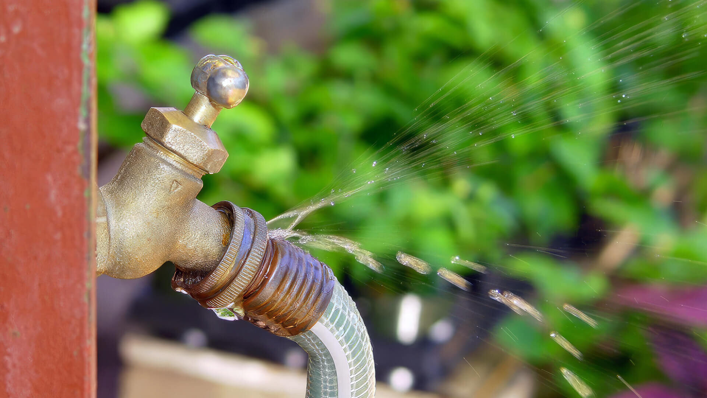
Site/ Aisle Guardians
Maintenace role that does not necessarily require maintenance skills
Required for the whole site or one (or more) in each aisle (four people, at least, in total)
Regular visits required, when you chose
Report to the Volunteer coordinator
Notes:
We are also hoping to recruit main Site Guardians. The role of Site Guardian covers the maintenance of the sites. This includes monitoring the conditions of the common areas such as the trackways, taps, fences, gates etc. Our extension site has a single Site Guardian. It’s a smaller site, although I don’t doubt, he would appreciate help. We last asked for a single ‘Site Maintenance’ role for the main site without success, so we have devised a new plan.
We would like to propose recruiting Guardians for each of the aisles- Aisle Guardians- dividing up the main site into four. That would mean there would be one person who’s task it is just to keep an eye on their own aisle. We have also changed the title of the role from ‘Maintenance’ to ‘Guardian’ to open up the role to people who may not feel they have the skills to change a tap- for example- but who would be the one to check them on each visit and report any problems to the Volunteer Coordinator who would report to the committee to arrange repair. People in this role would decide when to undertake the task- most likely on each visit to their plot. The initial task isn’t going to take very long at all- have a walk the length of the aisle and report any findings. Ideally, volunteers would at least remain until next years AGM. They would find that once the Winter sets in, activity would be minimal.
We already have two people for Aisle 1, plots 1-20. We need someone, or some people for Aisle 2, plots 21-45, Aisle 3, plots 46-68 and Aisle 4, plots 69- 87.

Slide 8
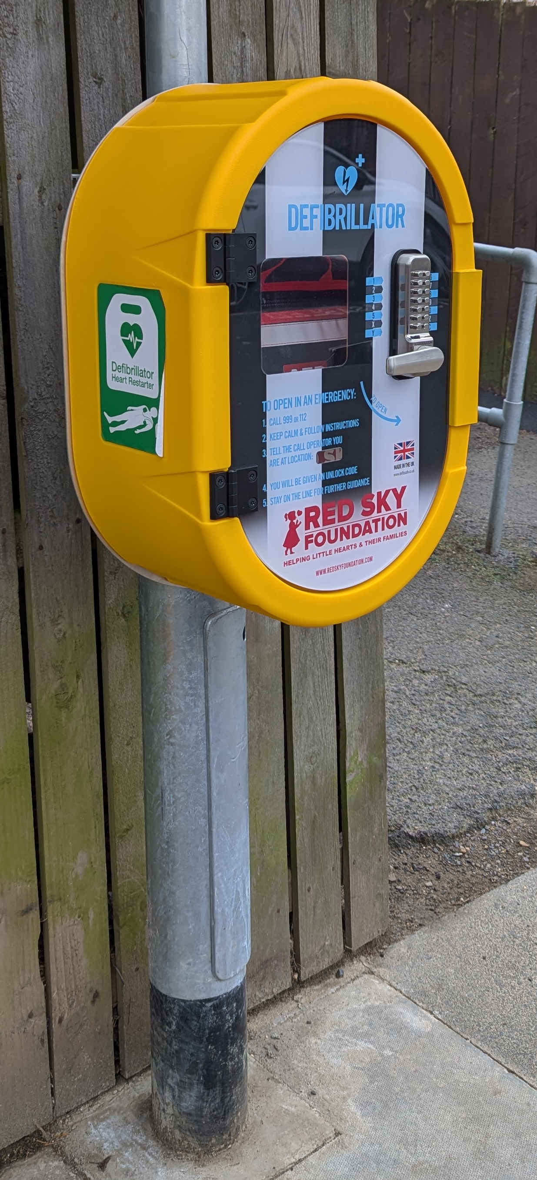

Defibrillator
Water meters
Stand Alone Tasks
Notes:
As well as roles, there are two single occasion tasks would are looking for help with. We would like to install a Defibrillator between the sites. Some of you may have noticed the new Red Sky Foundation Defib at the top of Hillcrest. Wonderfully, they have a step-by-step guide on their website as to how community groups can get one. It should be a straight forward task to look into this to fully understand what we would need to do and report this to our committee. Once the task is complete, that’s it. Unless you like it and want to help some more!
The second task concerns the water meters. They are very old. We need someone to contact the water company, ascertain who to discuss it with and determine how we can get them updated. Once again, once the task is complete, that’s it.
If you are interested in any of these roles, please see me at the end of the AGM and we can meet up and discuss it further or you could email. At the side of the room, I have also put a list of groups we are setting up and if you’d like to be part of one, or two. Remember- volunteer roles fit around you and your life, you will be fully supported. I’m proud to be part of this community and I very much enjoy spending time among fellow volunteers who I have found to be kind, knowledgeable, generous and great fun. It is a lovely way to spend time with people.
I’m going to hand over to Richard for the Financial Presentation and he will be followed by Iain for the shop presenation.

Slide 9

Finance

Slide 10
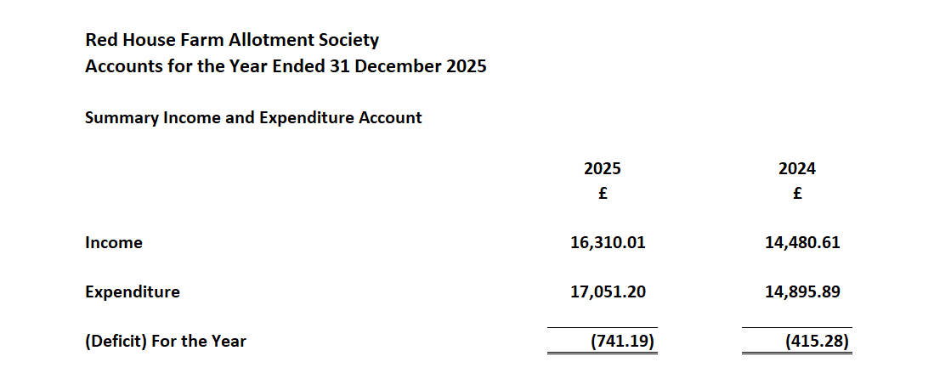

Slide 11
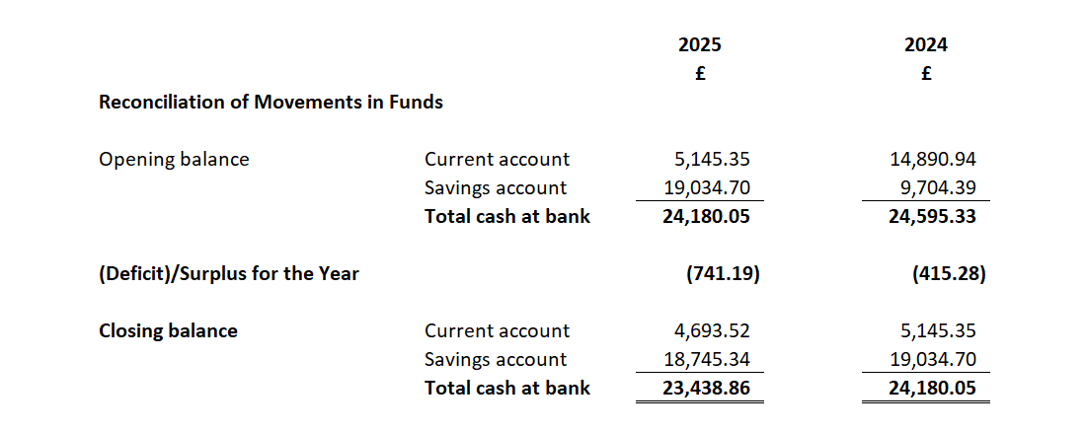

Slide 12


Slide 13
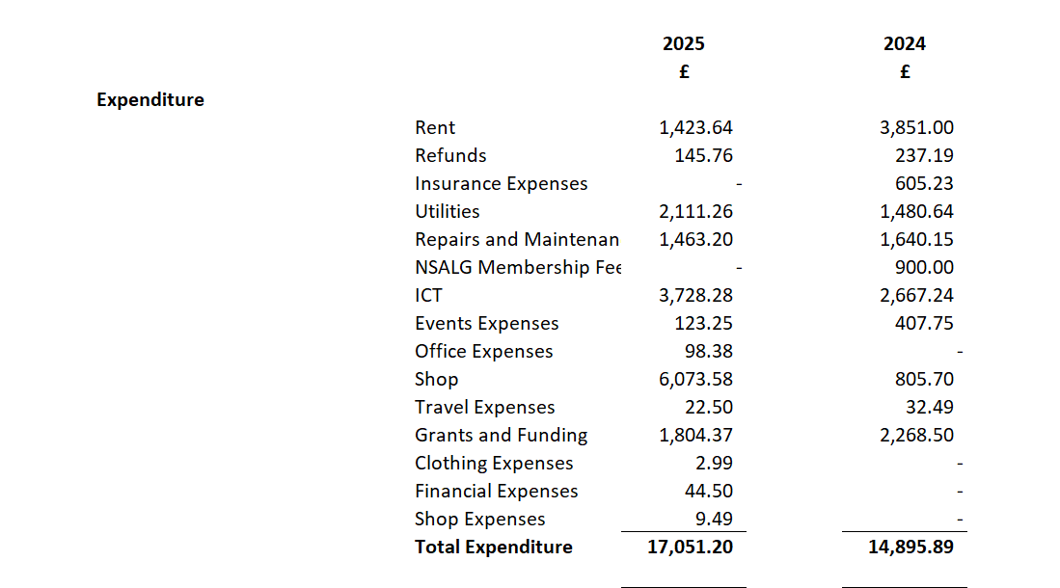

Slide 14
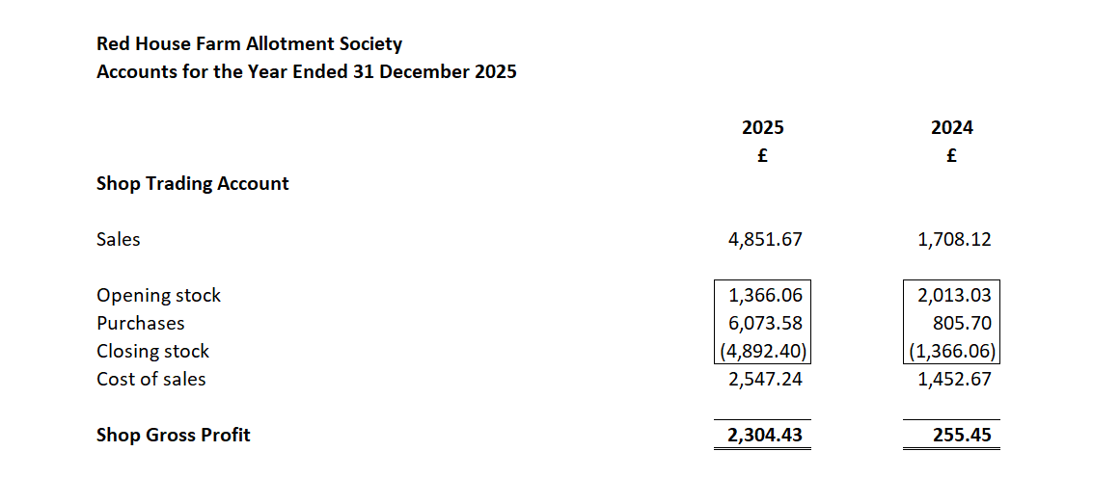

Slide 15
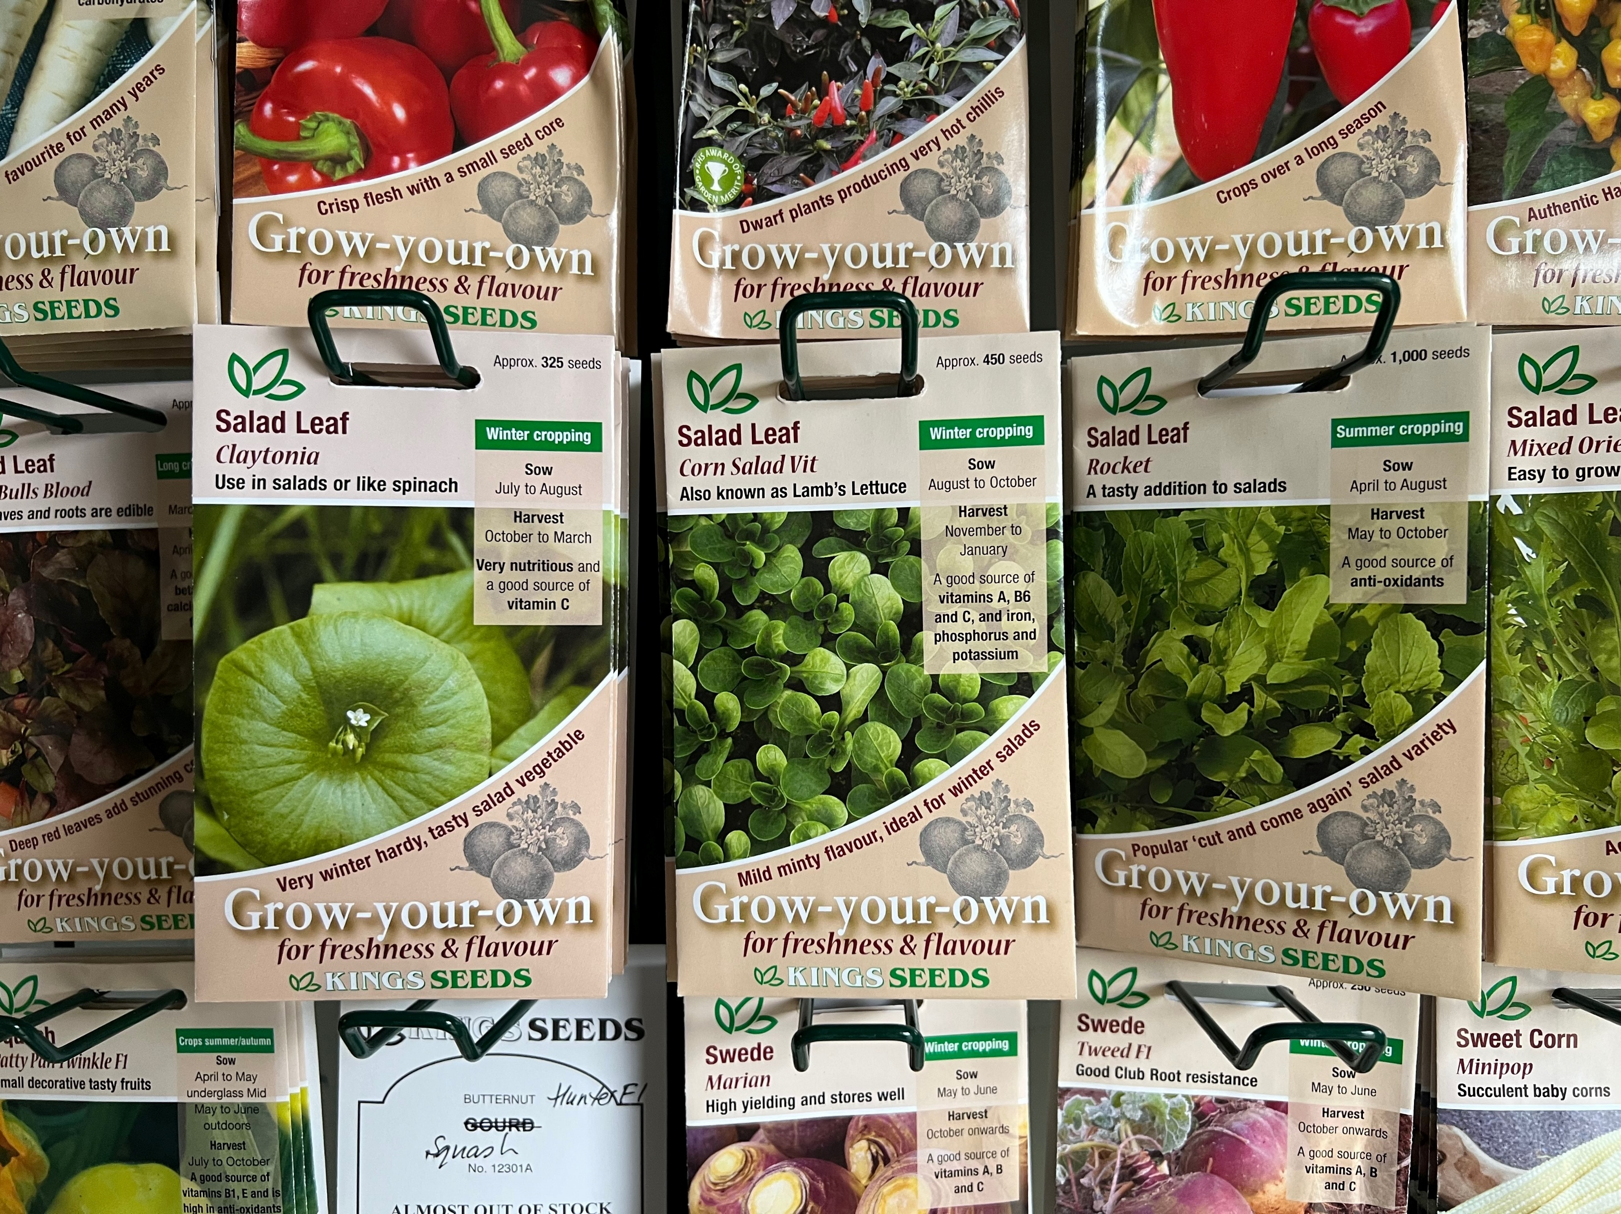
Allotment
Shop
2025
Presented by Iain Lynn​

Slide 16
A Major Step Forward in 2025
- open twice a week,
- much more publicity,
- more shop volunteers,
- made sales of almost £5,000

Slide 17
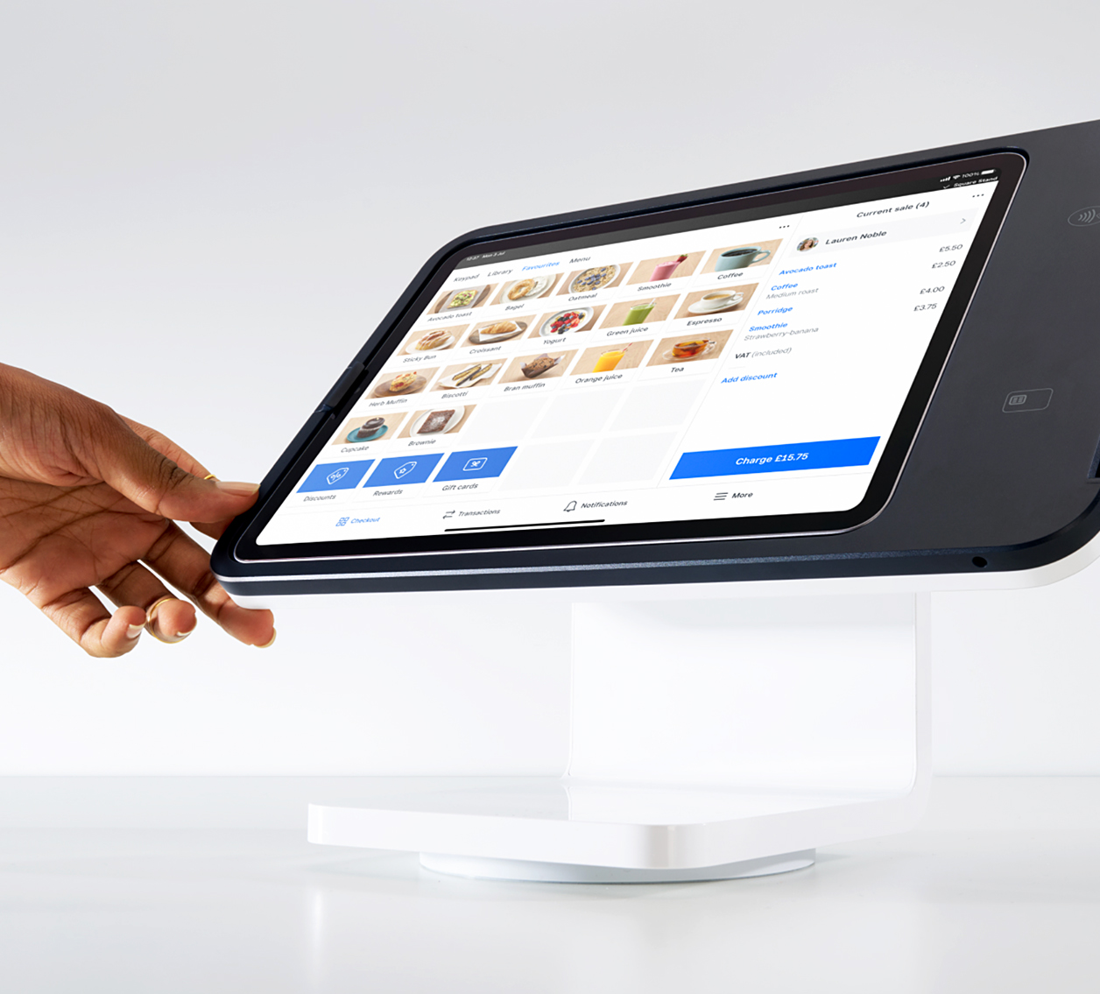
ePOS
Electronic Point of Sale

Slide 18
So Where Are We Today?
Now have two additional major suppliers
- liquid plant feeds
- netting, fleece, slug repellants
- hand tools and hardware items.

Slide 19
Pricing Policy
  - buy in bulk at trade prices
  - sell at the price we buy it – plus 5-10% (approx.)
  - shop overheads – delivery, packaging, bank
  transaction fees, internet data
  SUBSTANTIAL SAVINGS FOR MEMBERS

Slide 20
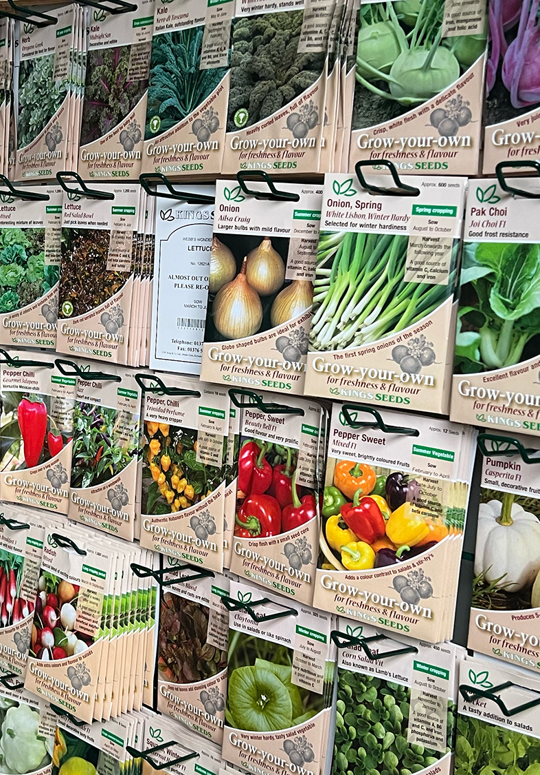
For example…
SEEDS – half the price on the packet
FERTILISERS – 1 kg Blood F&B costs £1.20
- at B&Q costs £1.70
PEAT-FREE COMPOST
our price - £9.15
Amazon - £15.12
Dobies - £21.99 + delivery

Slide 21
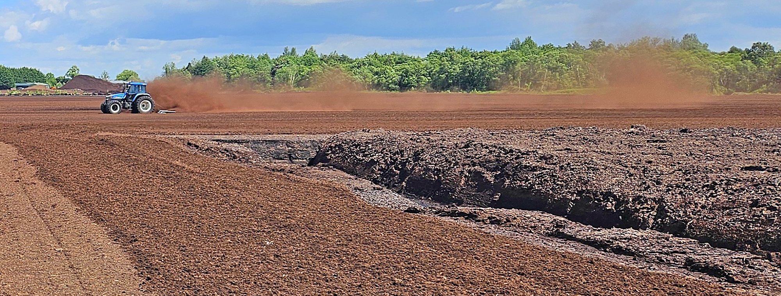
Peat products
Growing preference for peat-free composts

Slide 22

Plastic
Reduce our use of plastic
Use recycled plastic where possible

Slide 23
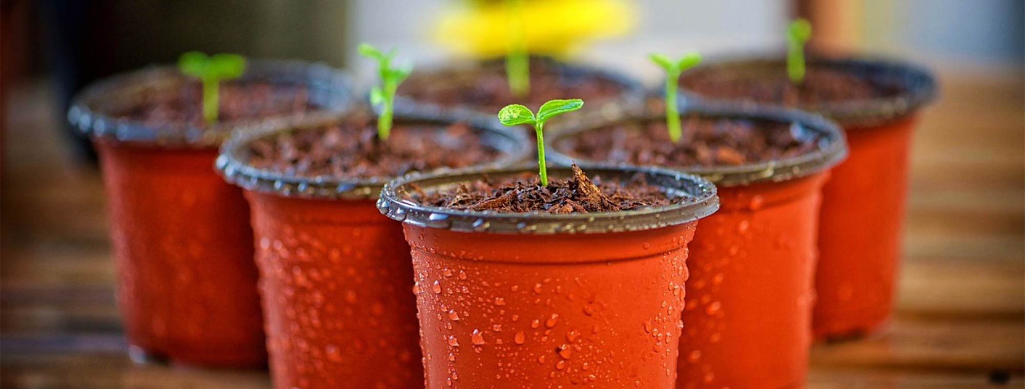
Biodegradable
Expensive – up to 4 times more
Short shelf life

Slide 24

Biodegradable

Slide 25
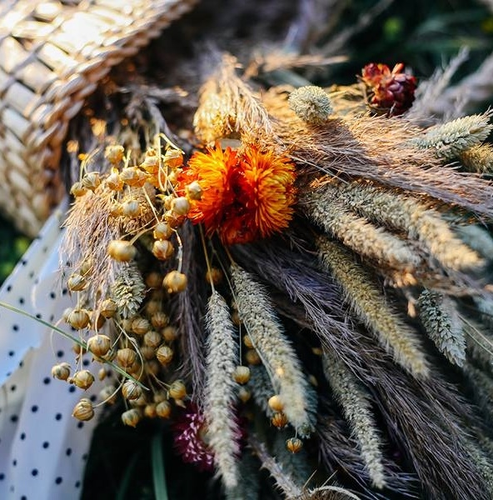
Elections
Michelle Tones- Chairperson
Katie McInerney- Secretary
Richard Lowery- Treasurer
Roger Bolton- IT Lead
Chris Forster- Allotment Allocations
Iain Lynn- Shop Manager and Newsletter Author
Keith Sizer- Extension Site Guardian
Notes:
We are going to do this a little differently this year. All of our current committee intend to continue for another year. Instead of voting for each one, I’m asking if anyone like to be considered for an existing role- no one is going to feel offended, I promise. Please raise your hand if you would like to be considered for an existing role. If you’d like to shadow a role with a view to putting yourself forward next year, please let us know.
Please raise your hand if you have any objection or concerns to all members remaining for another year.
Otherwise, please show your hand if you agree to all committee members standing for another year.

Slide 26
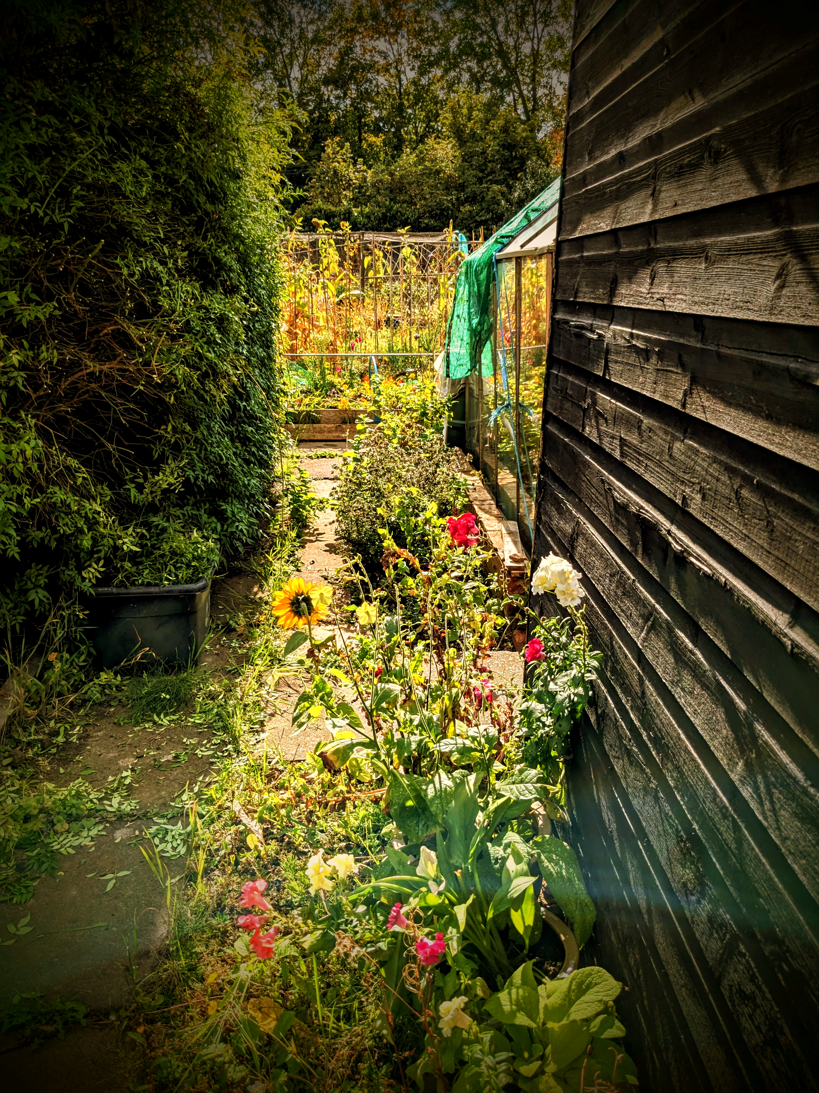
Thank you
Any Other Business?
Mirjam Nilsson​
mirjam@contoso.com
www.contoso.com
Notes:
Any other business. It has been a pleasure, as always. Thank you for supporting our community today.

